Slide 1
The Central Massachusetts Workforce Needs Assessment

Slide 2
Autism Services in Massachusetts
Policies such as Autism Omnibus Law (2014), Act Relative to Insurance Coverage for Autism (ARICA), and Achieving a Better Life Experience (ABLE) help individuals with the cost of therapies
In Massachusetts, there were 60 resources for transitioning to adult services for people with autism
The AFAM employment task force’s goal was to increase employment opportunities for people with autism. To obtain that goal, they were provided a range of job training and job development opportunities.
Disabilities Assistance and Bill of Rights Act (1984) enables people with developmental disabilities to receive employment-related services, such as job coaches

Slide 3
The Survey
We based our survey on the Bureau of Autism Services’s survey for Pennsylvania.
We believe that using this survey as a guide would produce the most beneficial results to accommodating needs for employment for individuals with autism.
We chose survey questions that generate a discussion on providing individuals diagnosed with autism with the services and support they need to becoming employed.
More information about the survey and results can be found at: HMEA.org

Slide 4
Three Main Points of Individual Survey
1. Barriers to getting a job
2. Type of support wanted
3. Successful support provided by employer

Slide 5
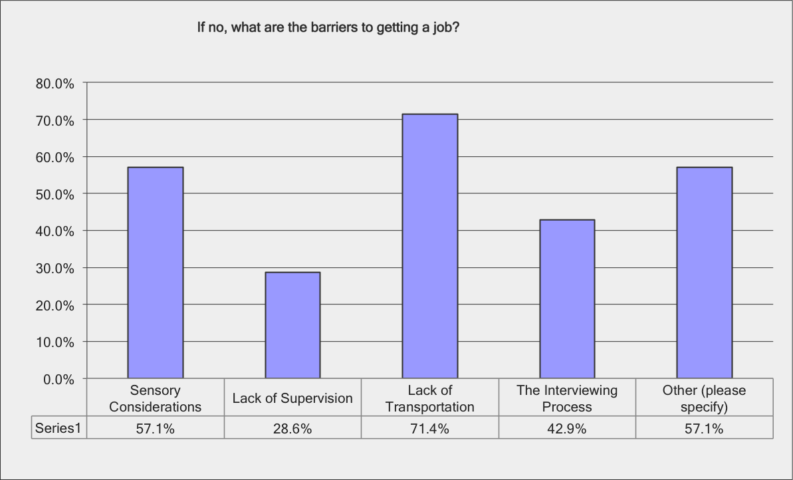
Barriers to Getting a Job
Other included:
having no experience
or education, needing
a 1:1 aid, and not
Understanding
directions.

Slide 6
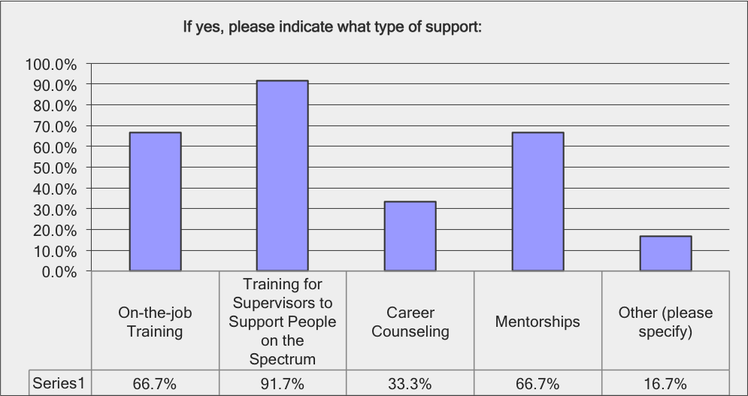
Support Needed at Work to be Successful
100% of participants
answered “yes” to
thinking that they
need support at
work to be
successful.

Slide 7
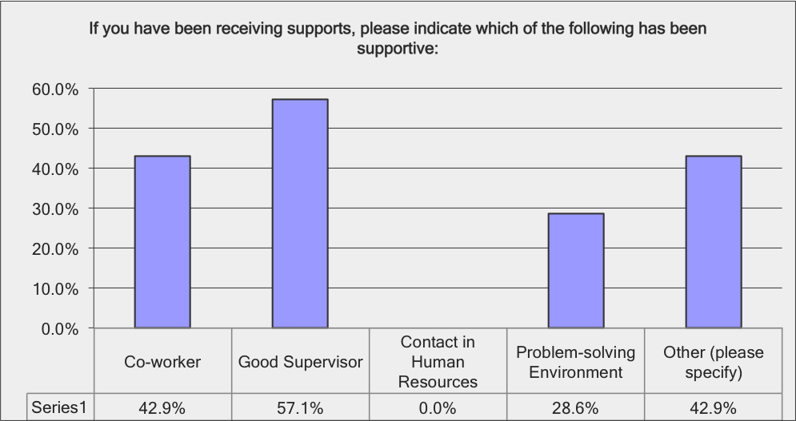
Support by the Employer found Successful
Other included:
a job coach to match
the individual’s skills,
and the individual’s
parents.

Slide 8
Three Main Points of Family Survey
Individuals with Autism need more supports from employers
Supports that have been helpful for their family member
Barriers their family member with Autism have faced when finding employment

Slide 9
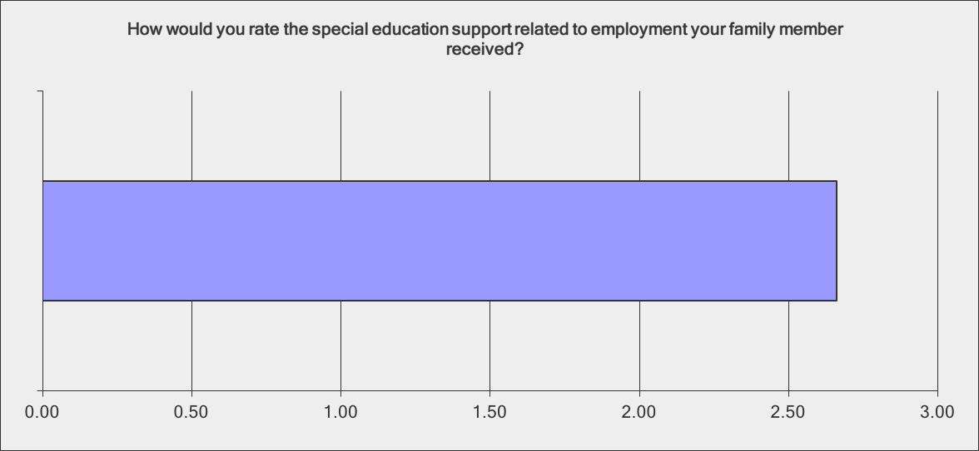
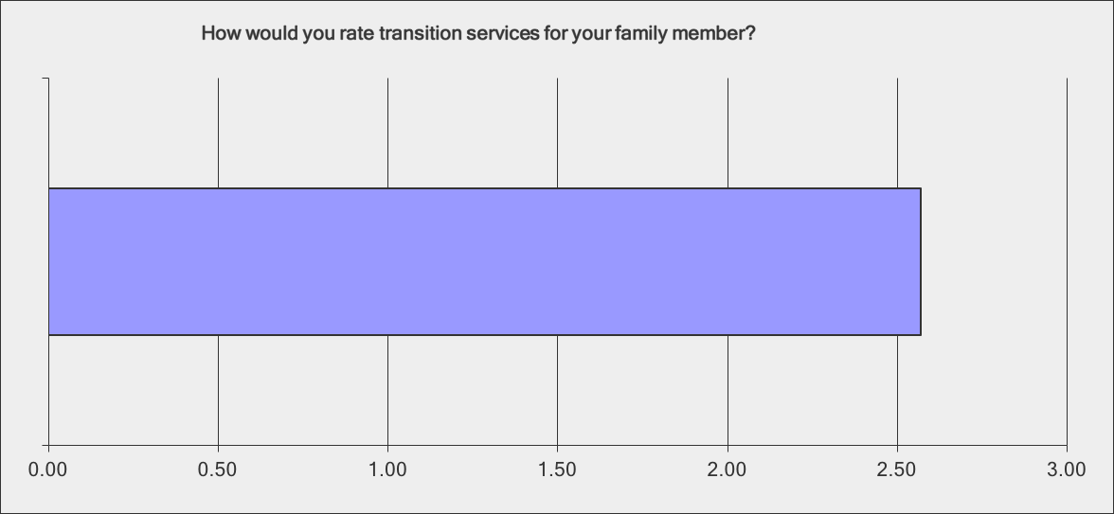
Do Families Receive the
Proper Support for Success?
When family members were asked to rate the special education support, the average rating was 2.66 out of 5, with 5 being excellent.
When family members were asked to rate the transition services available, the average rating was 2.57 out of 5, with 5 being the excellent.

Slide 10
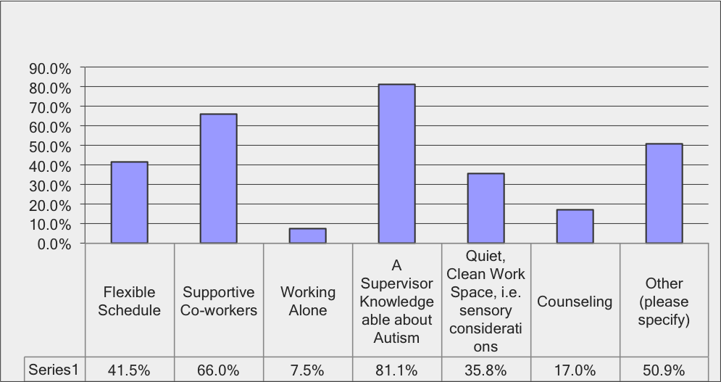
What Supports have been Most Helpful?
When asked to check all services that have been most helpful for their family member, participants indicated that the supervisor’s knowledge about autism was most important.

Slide 11
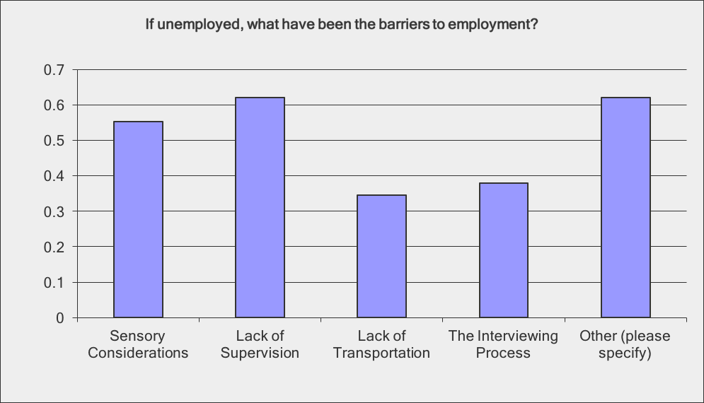
Barriers of Finding Employment
Families indicated that lack of supervision was the biggest barrier to becoming employed.

Slide 12
Three Main Points for Employment Survey
1. Knowledge about employees disabilities
2. Support offered within the company
3. Assumptions employers make about the characteristics of people with Autism

Slide 13
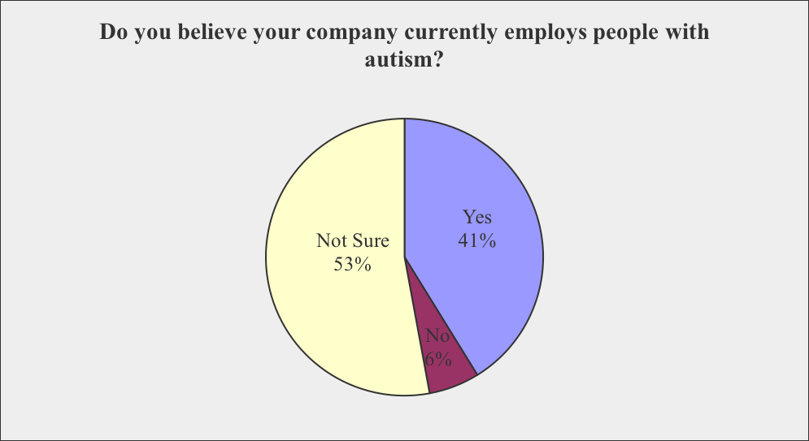
Employer Survey: Knowledge about Potential Disabilities
Notes:
17 respondents
67% employ over 200 employees, 11.8% employ between 100 and 200 employees, 11.8% employ between 1 and 50, 5.9% employ between 51 and 75, and 5.9% employ between 76 and 100
Yet, only 41.2% currently employ people with autism, 5.9% does not
52.9% reported that they are not sure

Slide 14
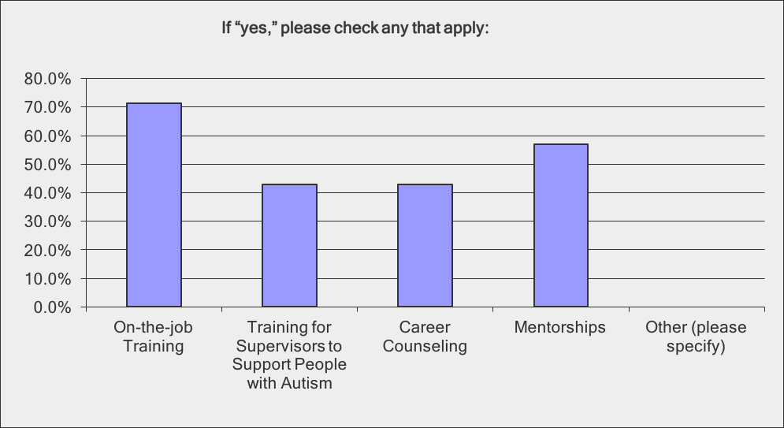
Employer Survey: Support Offered
41% of companies offer support that could benefit employees with autism.
29% of companies stated they did not offer any services, and 30% were unsure.

Slide 15
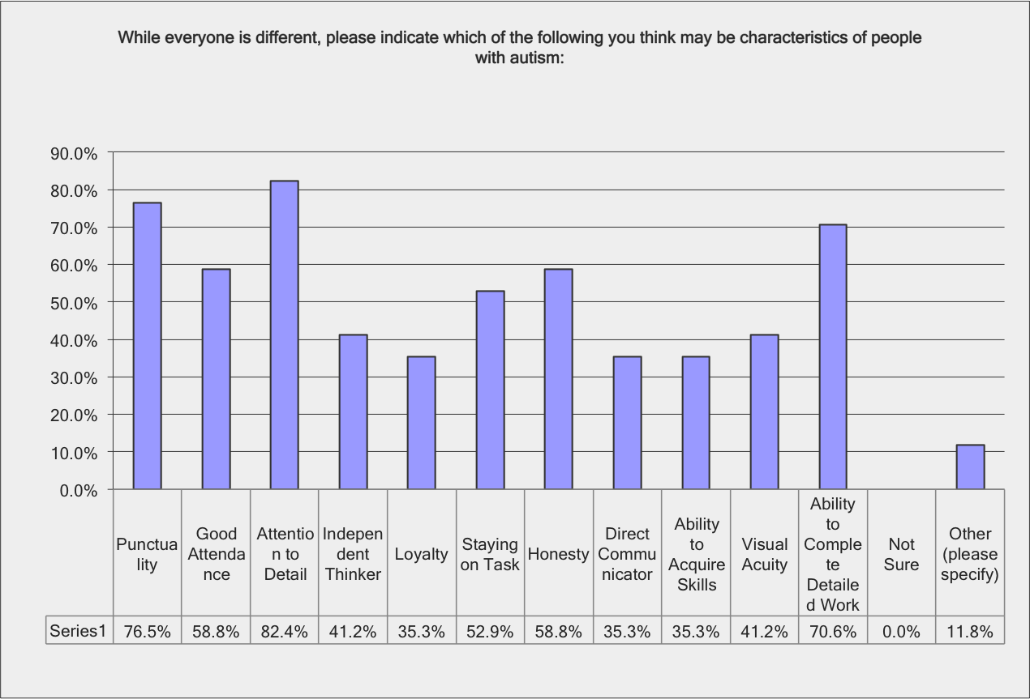
Employer Survey: Perception of Character Traits Possessed by People with Autism
Employers were asked what
traits they felt werecharacteristics
with people with Autism. They
could check off as many traits as
they felt applied.
The people who checked other
reported that they were unsure
and felt that they were not
knowledgeable enough to answer
the question.
Notes:
Highest
82% believed that they had good attention to detail
77% believed that they were punctual
70% believed they had the ability to complete detailed work
Lowest:
41% believed that they were independent thinkers
35% felt that they would be loyal
35% believed that they would be a direct communicator

Slide 16
Conclusion
More support from employers and fellow employees
Could be achieved through better education on autism, focused in the workplace and the specific challenges than can arise there
More transparency and communication is needed within companies so that the people in charge have knowledge of the special needs of their employees, to ensure that the workplace is accessible to everyone
Employers are willing to hire people with autism, and people with autism express a desire to be hired, which shows that the issue is in the actual application and interview process, as well as a lack of accessibility services
For more information about the results of this study go to: HMEA.org

