Slide 1
How to Apply in ADP
Please note:
All questions with a red asterisk*
Must be completed to continue the application process

Slide 2
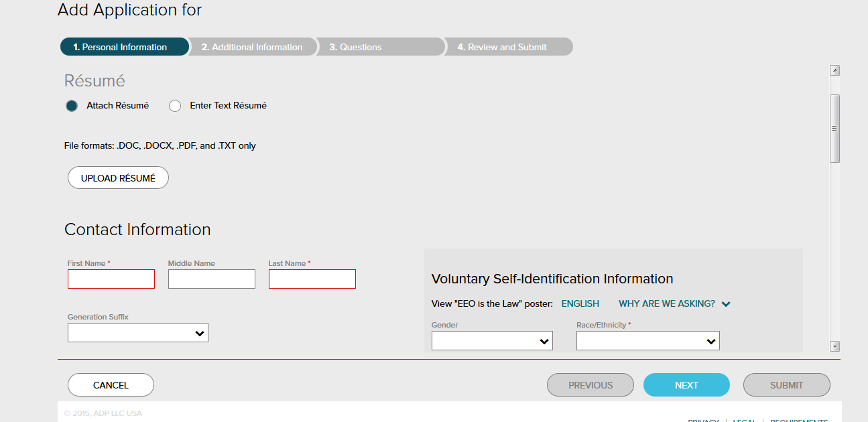
1. Personal Information
Upload Resume, enter contact information(name, address, email address) and voluntary self identification information.

Slide 3
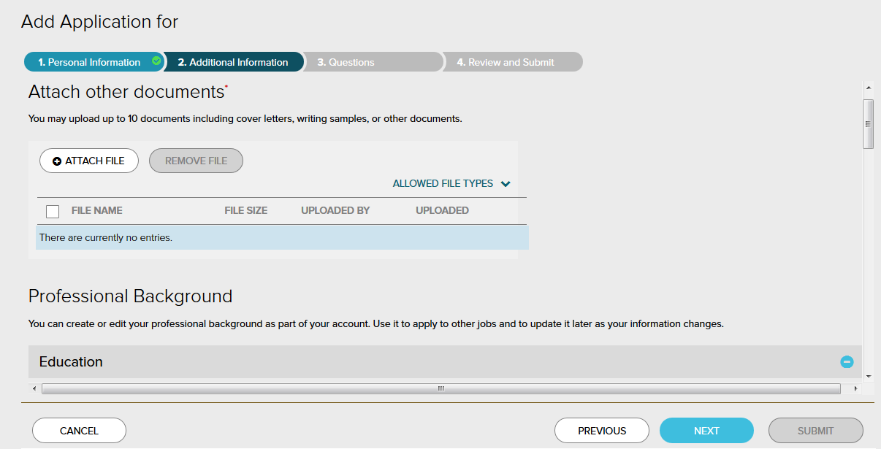
2. Additional Information
Attach other documents(cover letter, writing sample), professional background(education, employment history, skills, licenses and certifications, memberships)

Slide 4
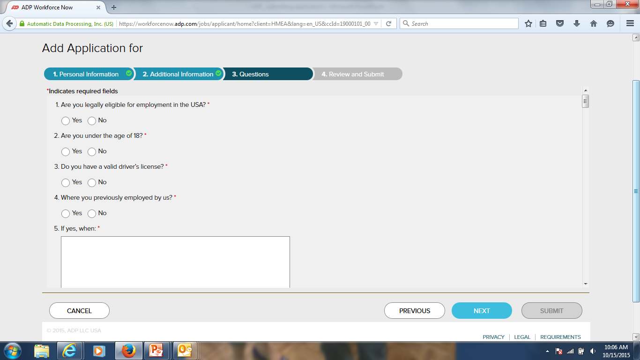
3. Questions
Eligible to work in the USA, drivers license, previously employed by us, school name, company name and address, references, applicant signature.

Slide 5
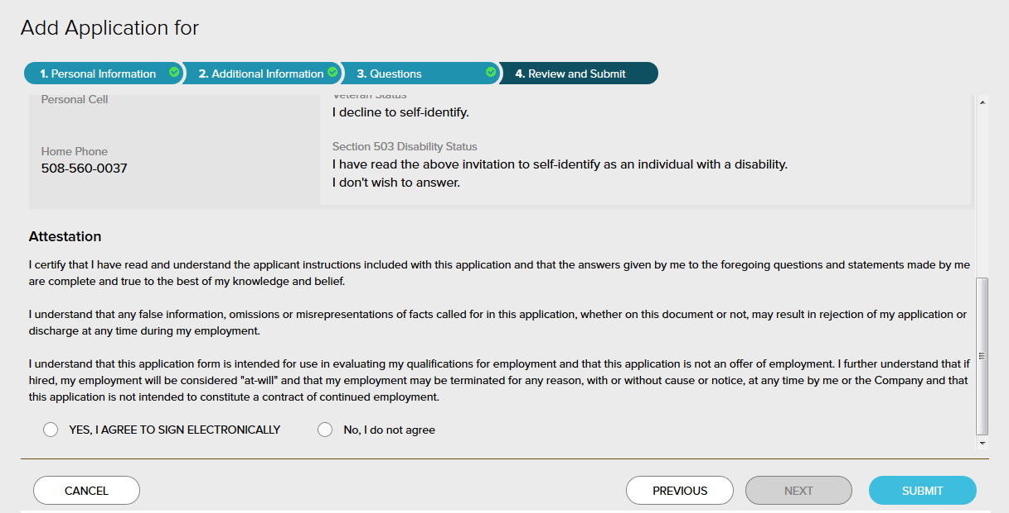
4. Review and Submit
Review personal information, additional information and questions. Agree to Attestation and submit.

